Slide 1
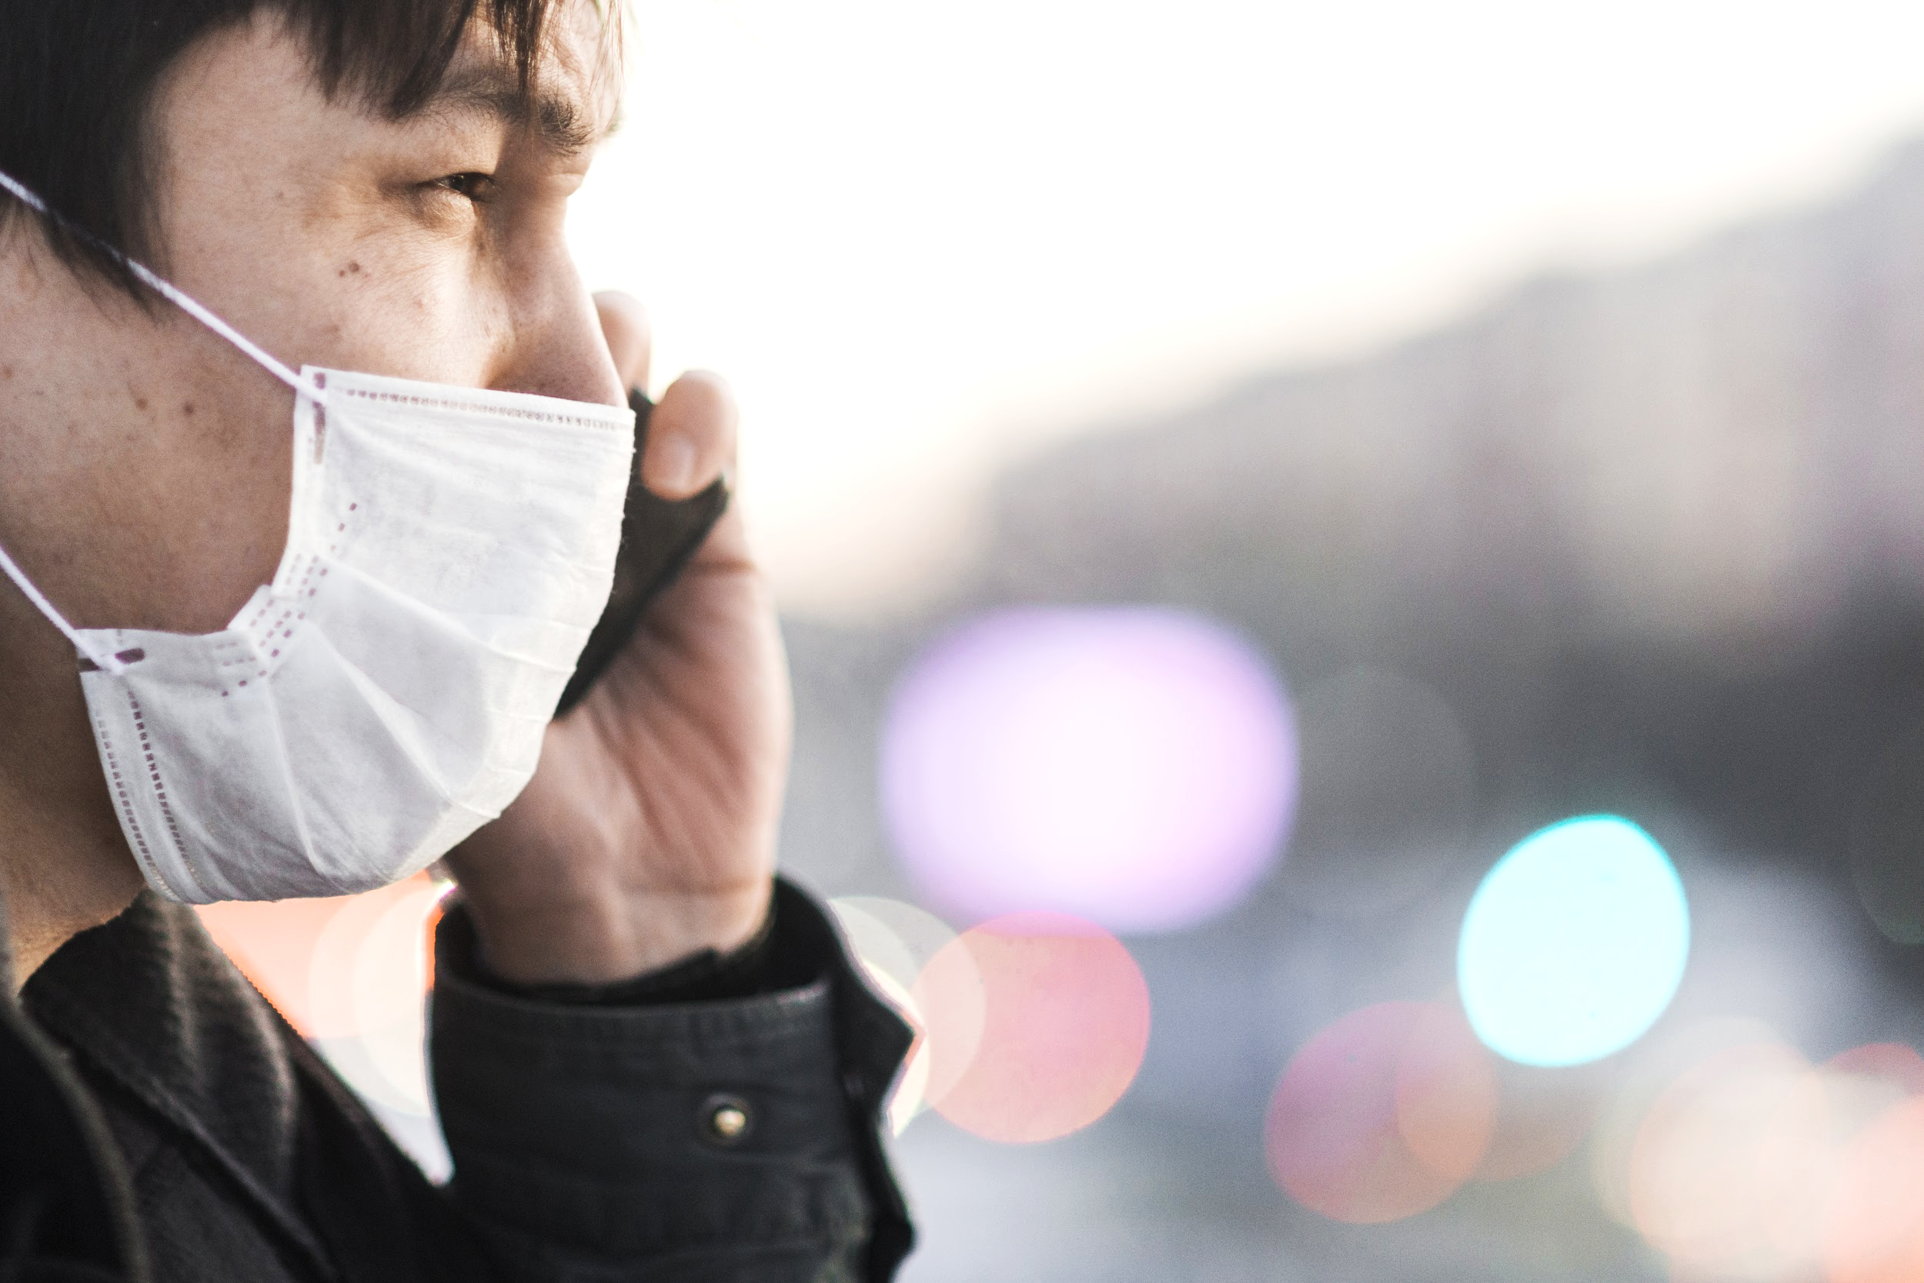
MASKED FACE RECOGNITION BASED ATTENDANCE SYSTEM USING DEEP LEARNING
Final Year Project

Slide 2
MGM’S COLLEGE OF ENGINEERING AND TECHNOLOGY, NAVI MUMBAI (BEIT 2020-21)
TEAM MEMBERS UID No.
Karishma Chandrakant Mokashi 117IT1065B
Supriya Tanaji Kodag 117IT1429B
Saurabh Raghunath Pawar 118IT3326A
MENTOR
Prof. Yogesh Shahare

Slide 3
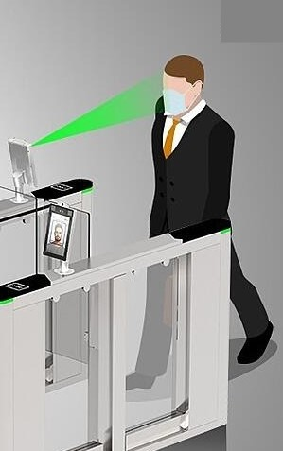
CONTENTS
Introduction
Motivation
Objective
Flowchart
Datasets
Implementation-Training and Testing
Software Development Tools
Conclusion
Challenge Prevent virus spread through touched surfaces
Solution Masked Face Recognition Based Attendance System

Slide 4
INTRODUCTION
Corona virus has affected every single individual over the globe.
Every individual is taking fundamental measures to decrease its effect.
Our project is to build an authentication system which would recognize face and detect whether a person on the camera is wearing a Face Mask or not and record the attendance only if the person wears mask.

Slide 5
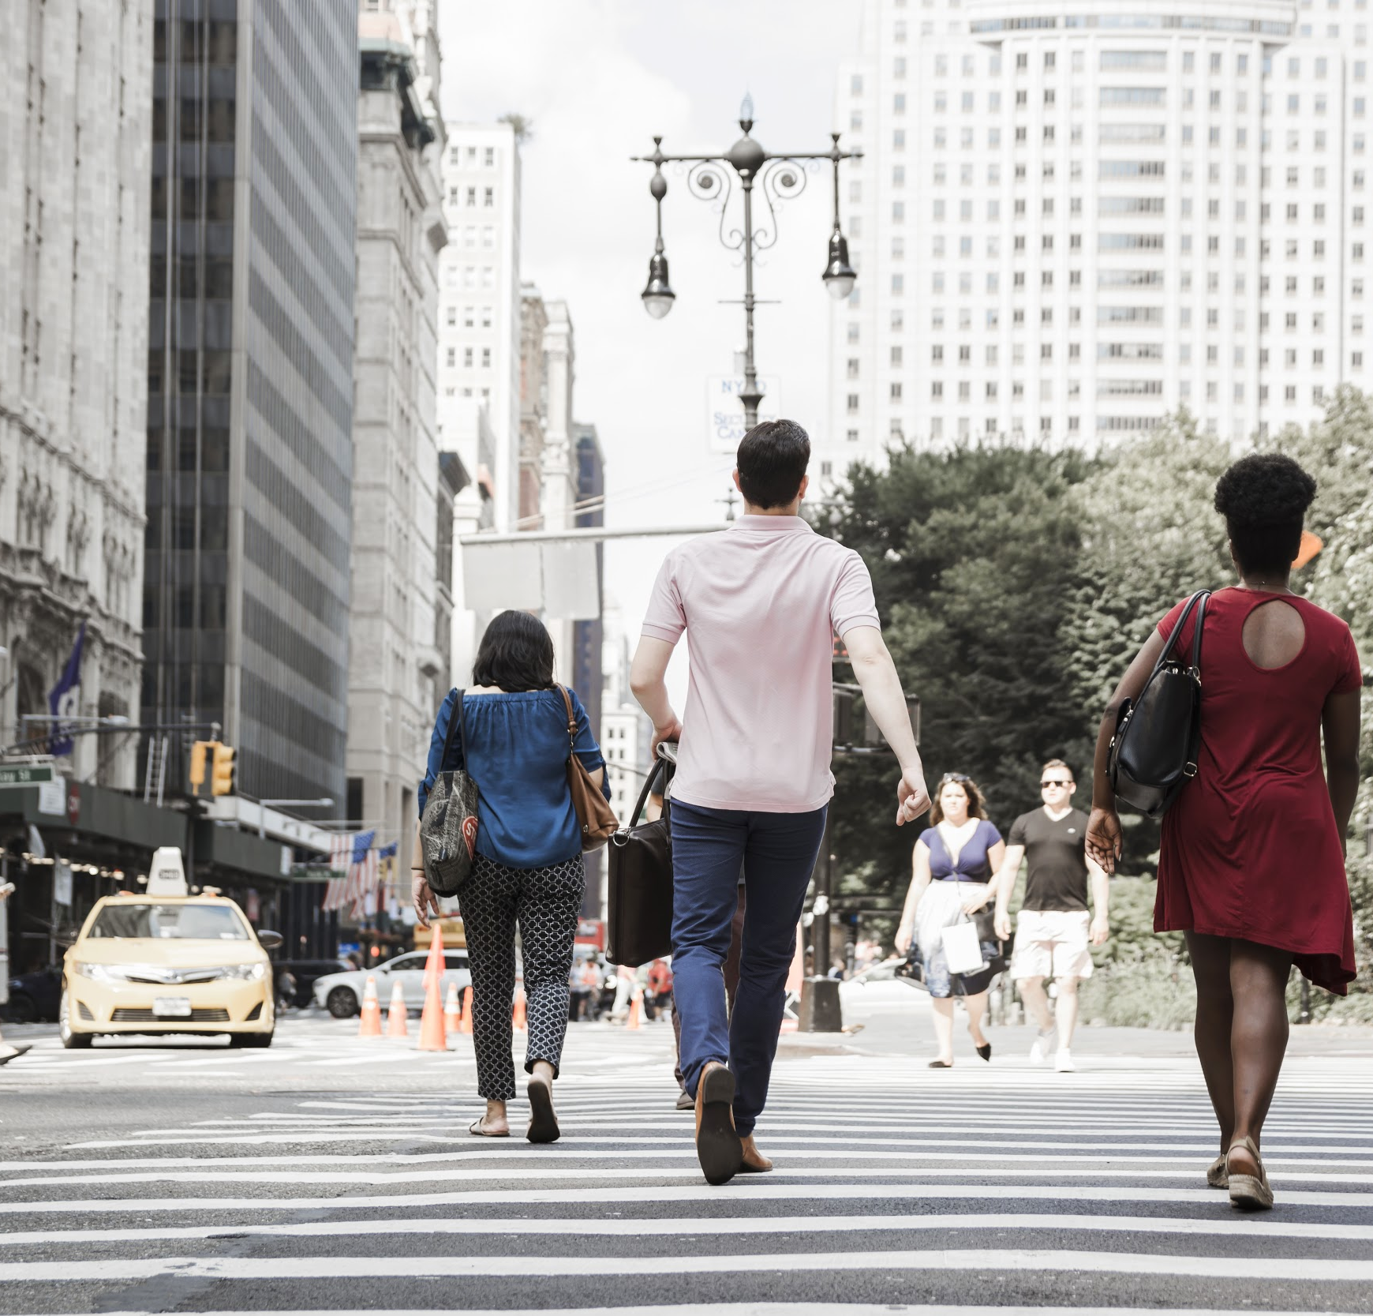
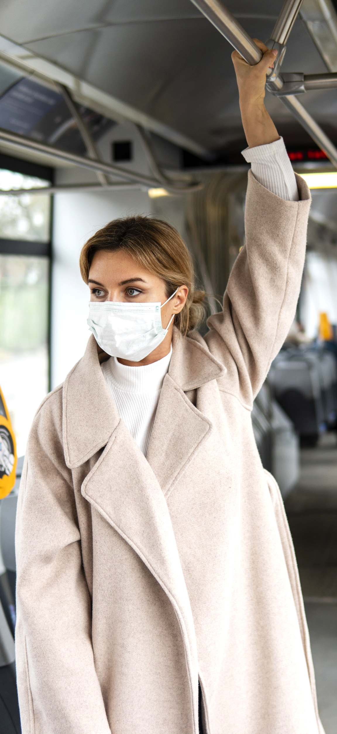
MOTIVATION
As the coronavirus is spreading rapidly, the World Health Organization has suggested to maintain social distance and to wear facemasks.
Also, cleaning and disinfecting touched surfaces lowered the chance of the virus spreading but didn’t solve the problem.
In support of the ongoing fight against this infectious disease, we are motivated to generate new insights, by building touch-less attendance system for masked face recognition using deep learning techniques.

Slide 6
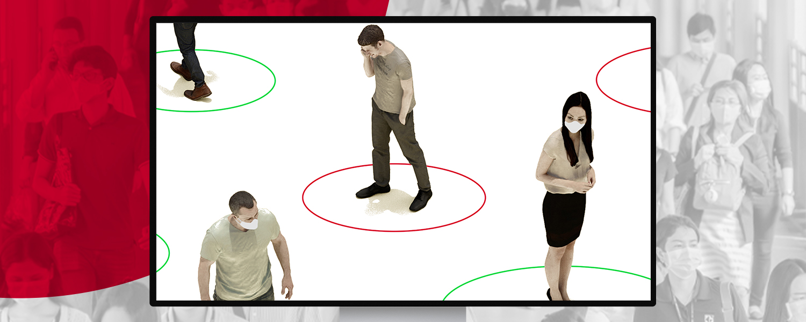
OBJECTIVE
A model is created using datasets with mask and without mask.
Two types of tests have been carried out, first one to identify person on camera with or without mask, second is to determine if it is able to recognize a person if he or she is wearing a mask.
The attendance will be recorded if the person wears a mask.

Slide 7
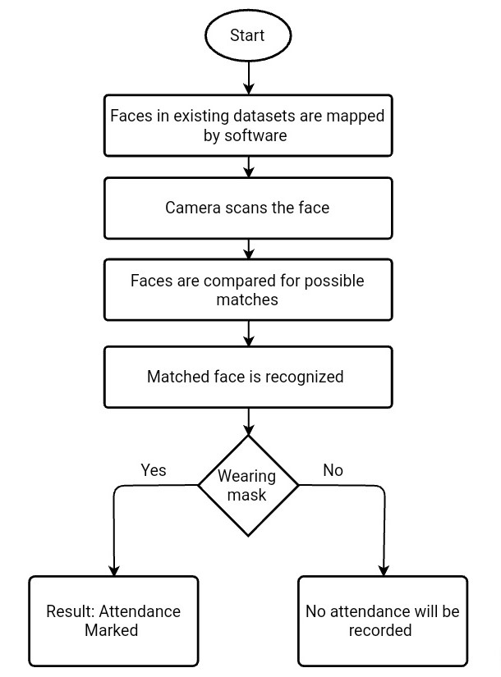
01
FLOWCHART

Slide 8
EXPLANATION
Phase 1: Train the dataset and build a model to recognize and detect face:
The datasets with and without mask are collected.
The first step is to discard the masked face region.
Next, we apply pre-trained deep Convolutional neural networks (CNN) to extract the best features from the obtained regions (mostly eyes and forehead regions).
Finally, Multilayer Perceptron (MLP) is applied for the classification process.
Phase 2: Apply the model and record the attendance:
Load the built model.
Cameras are switched on and the faces are detected using CV2.
Extract Face ROI(Region of Interest) in camera video.
Applying the built model to detect facemask and recognize face.
When the mask is detected the input image will label 'Mask' as an output on top of the bounded box, but if the person is not wearing the mask then it will label 'No-Mask'.
If it’s a match, the attendance will be recorded with name, timestamp and date.

Slide 9
DATASETS
Datasets are collected from Kaggle.
We have set constraints like single face and frontal view for high accuracy.
Two set of datasets composed of faces of various people from different parts of the world and of all age groups.
One set of dataset consists of faces of people with mask.
Other set of dataset consists of faces of same people without mask.
All the images in dataset are renamed with proper labels.

Slide 10
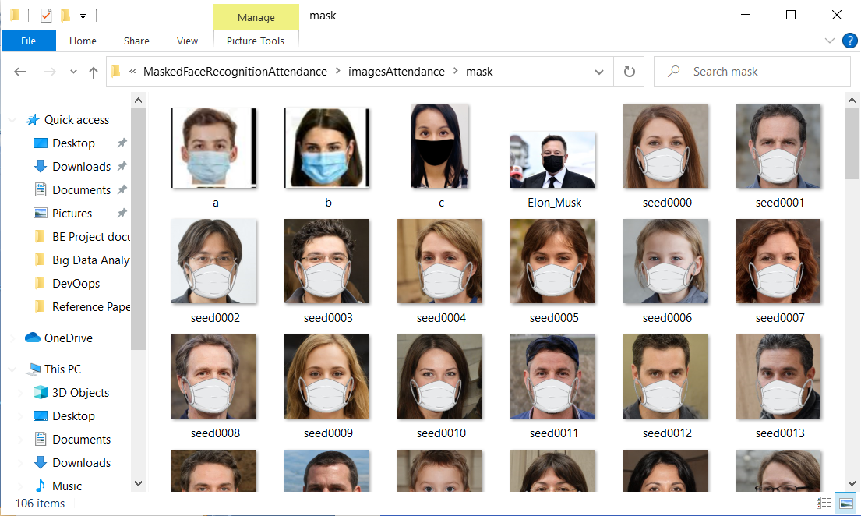
Dataset with ‘MASK’

Slide 11
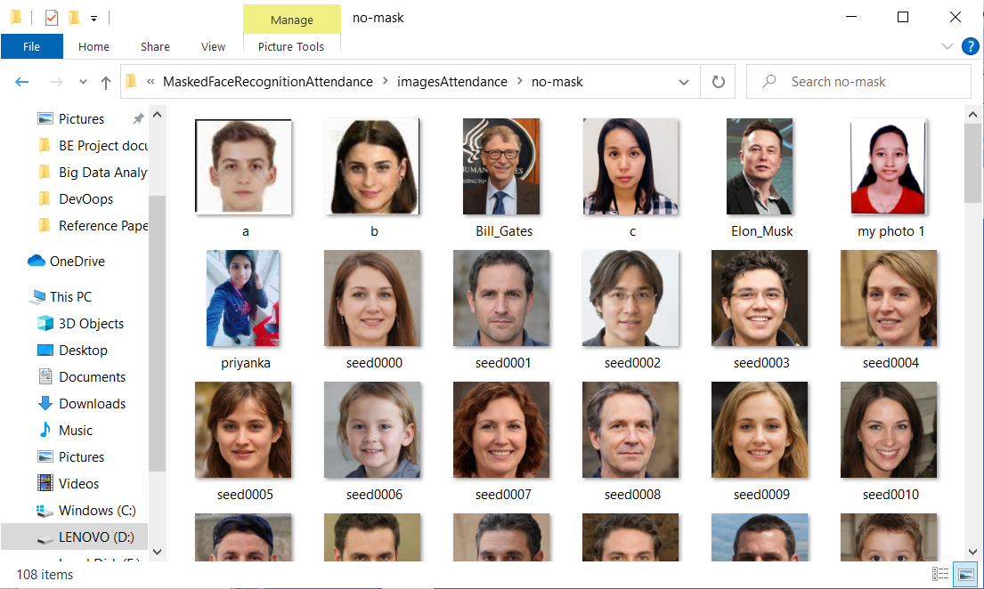
Dataset with ‘NO-MASK’

Slide 12
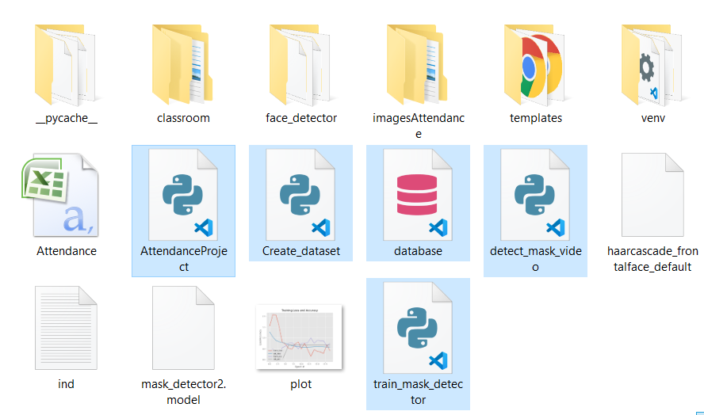
IMPLEMENTATION
Training:
- ‘Mask’ and ‘No-mask’ datasets are loaded by using train-mask-detector.py.
- Classifiers are trained using Convolutional neural networks.
- Models are built using data set.
MODEL:

Slide 13
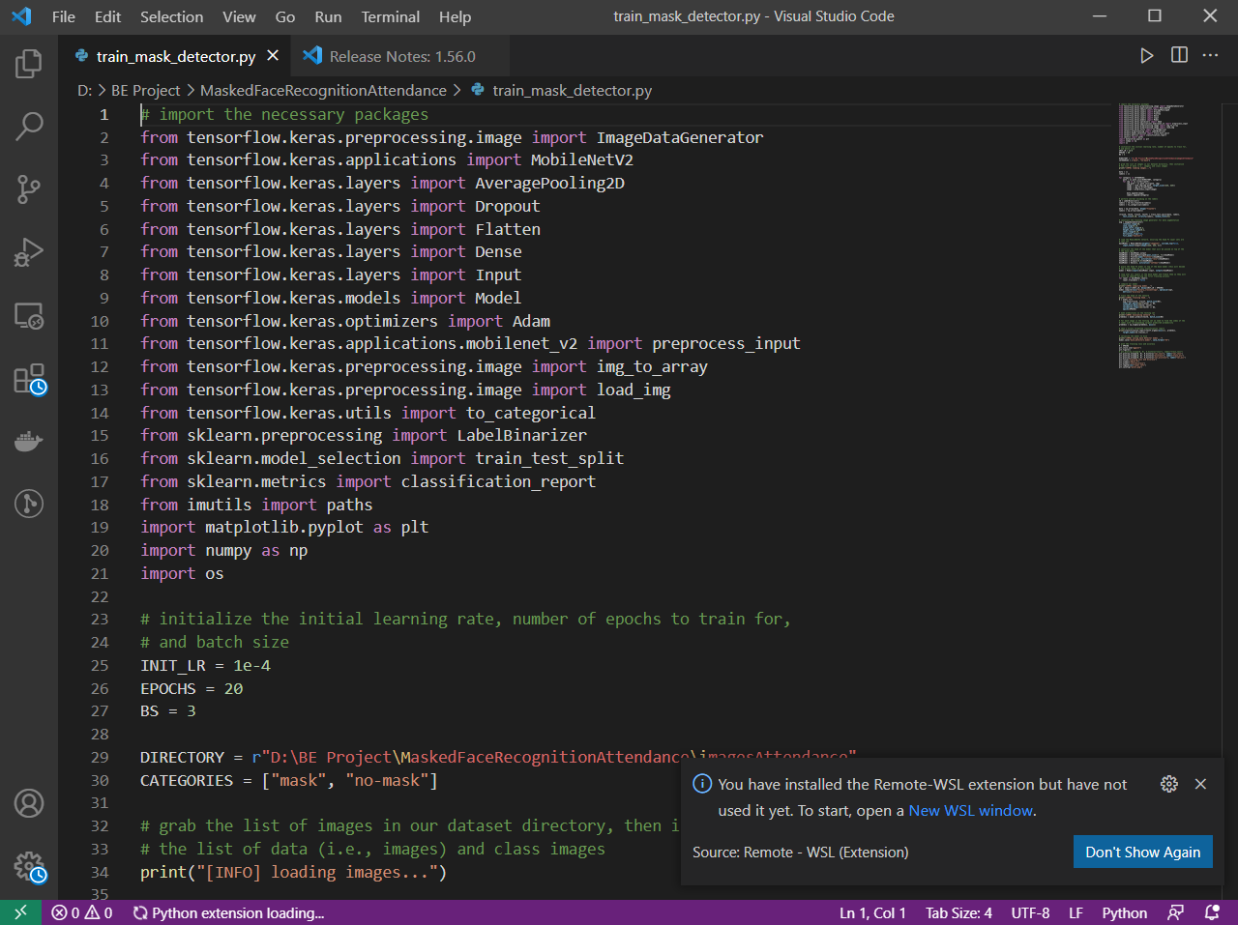
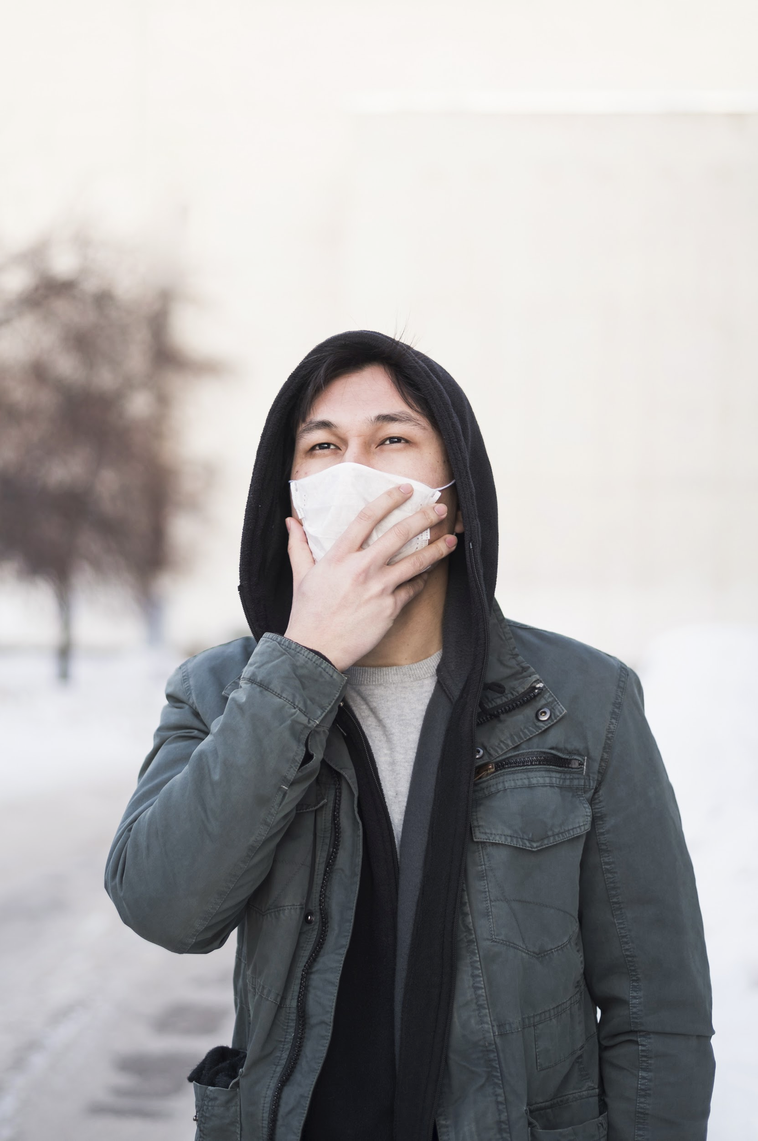
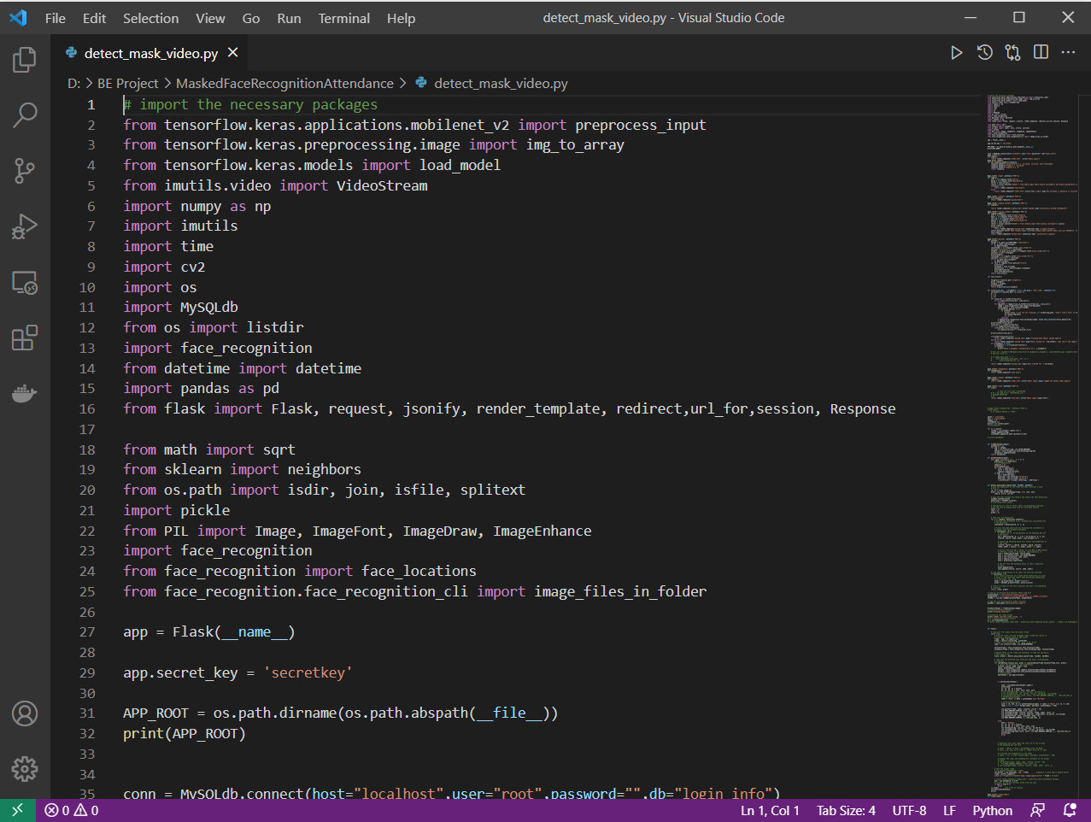
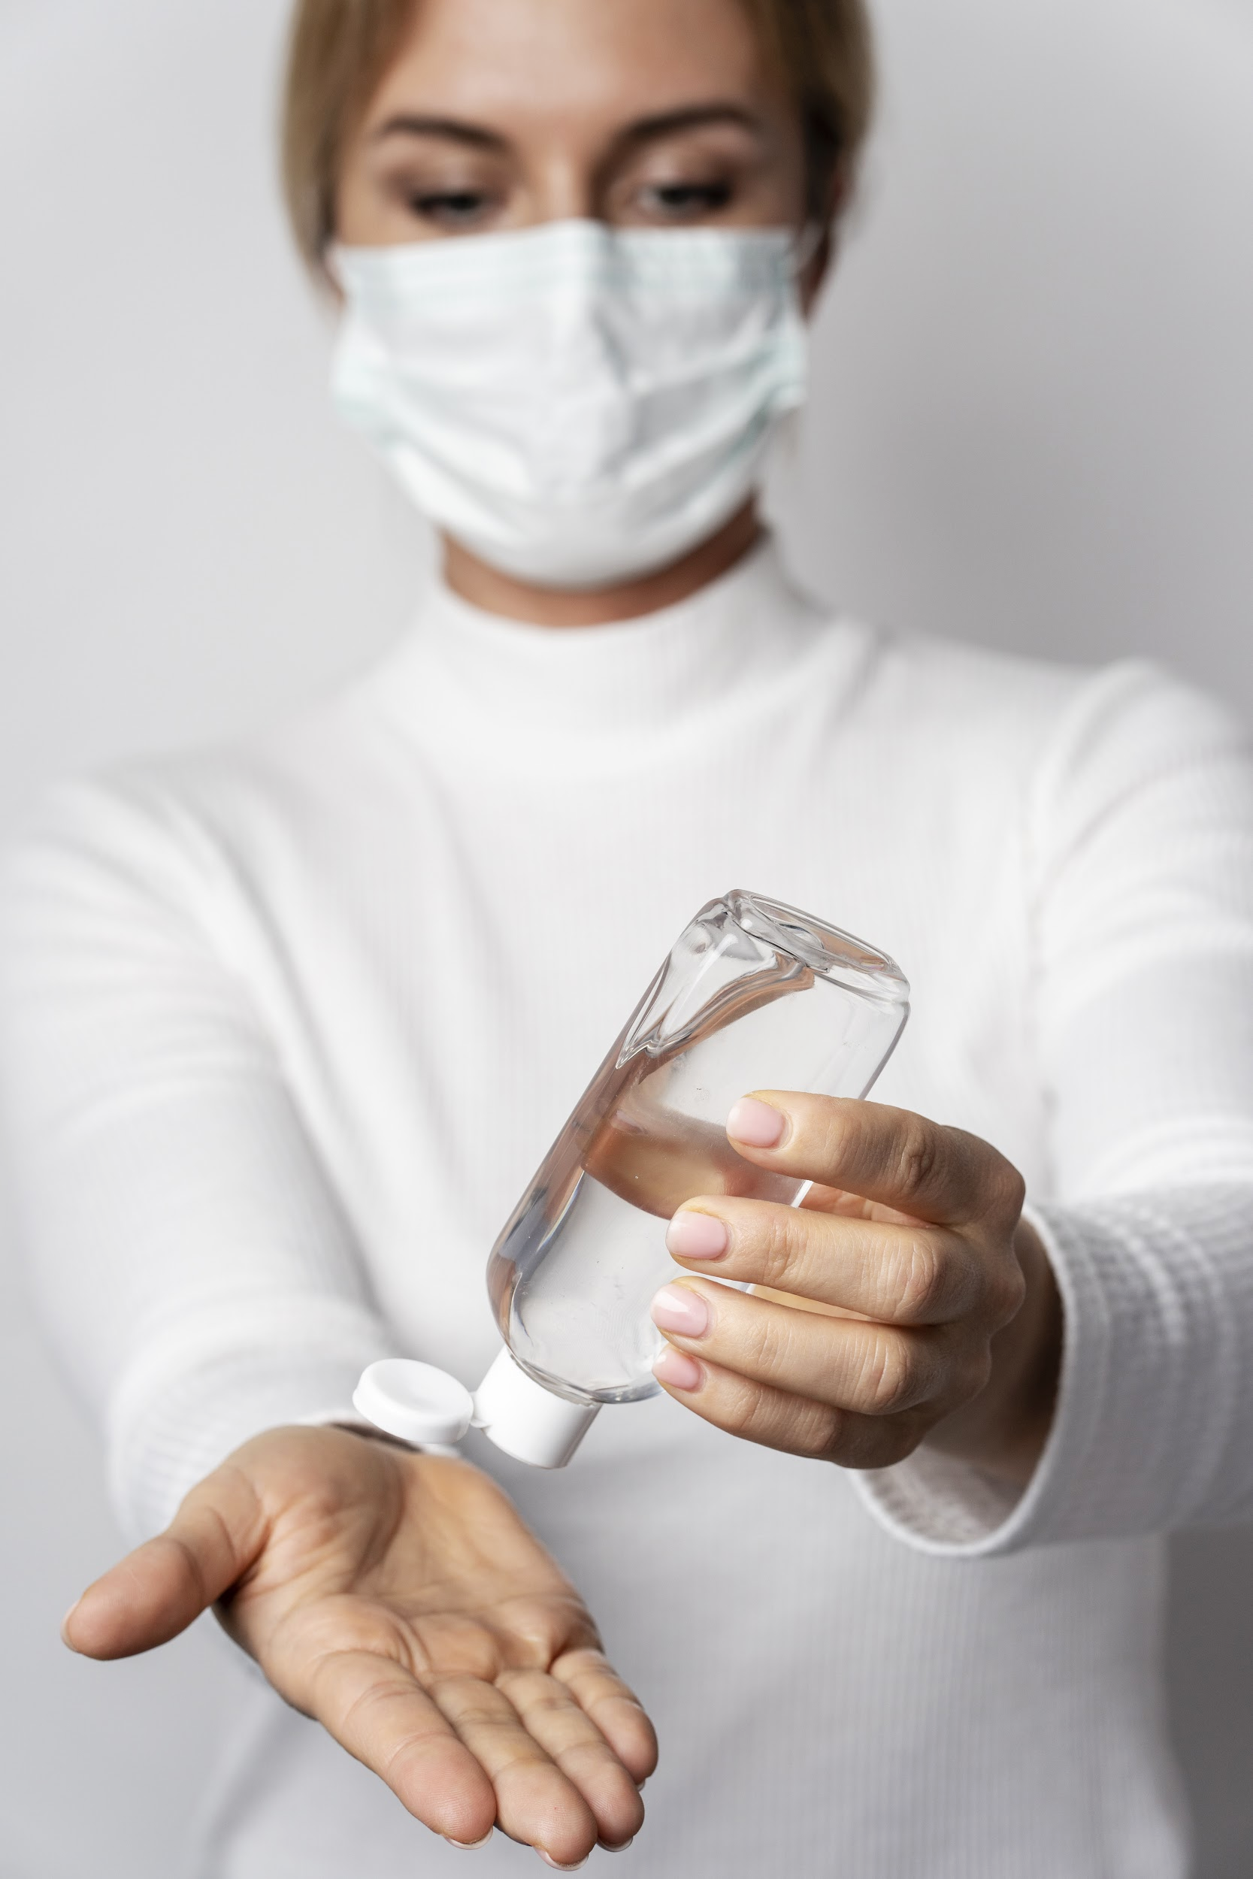
Training: Testing:

Slide 14
Testing:
- Built models are loaded using detect-mask-video.py.
- A URL is created which directs us to the dashboard of our project which is build using FLASK web framework(index.html).
- Admin can login to the portal by entering username and password created using phpMyAdmin(database.sql).
- After clicking on Mark Attendance camera is switched ON(AttendanceProject.py).
- Faces are detected using CV2.
Face Mask Detection: If identified a person without facemask, it is labeled as ‘No-mask’ otherwise ‘mask’(haarcascade-frontalface-default).

Slide 15
Face Recognition and cropping:
-The images collected using upload student data button are without masks and the folder is named classroom(Create-dataset.py)
- Each image in the classroom folder will be taken and its face encodings will be generated, basically, a cross-validation strategy will be used to evaluate the recognition performance.
-When the person is matched and recognized, the name will be displayed in the frame.
Store Recognized Entries
-The entry is saved in the file attendance.csv and can be viewed anytime by clicking Download Attendance.
- The downloaded file can be viewed as an excel sheet.

Slide 16
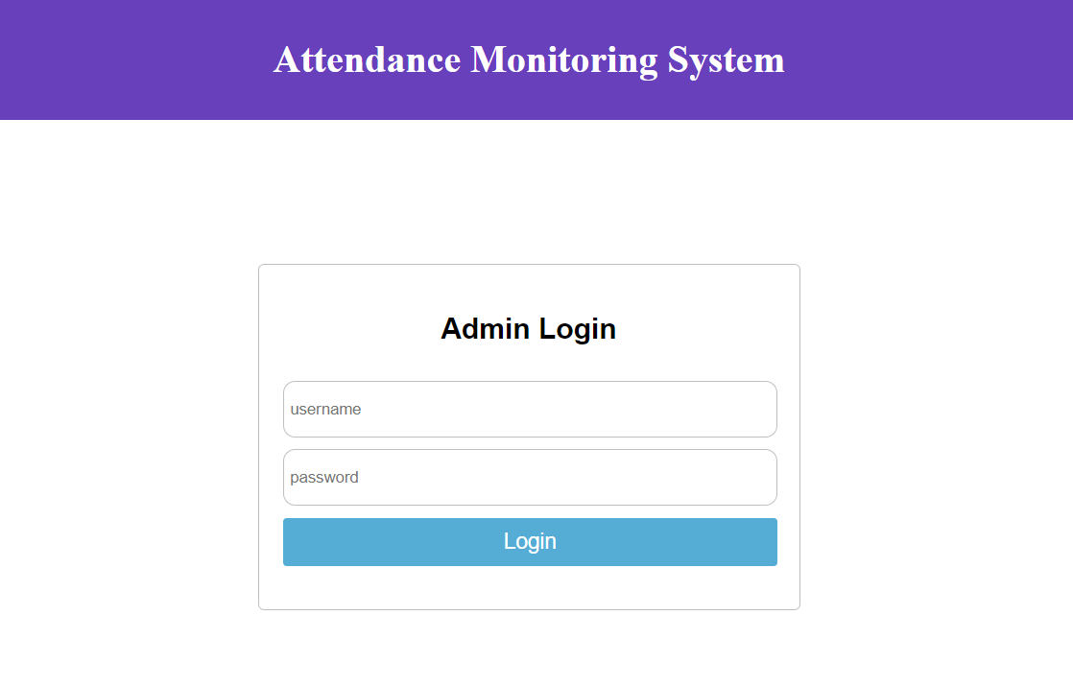
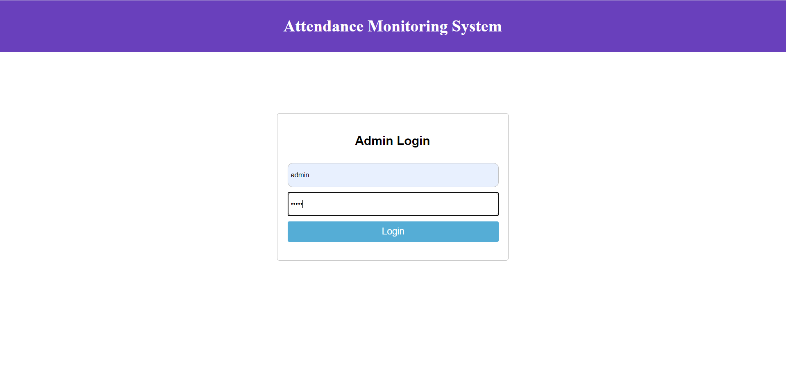
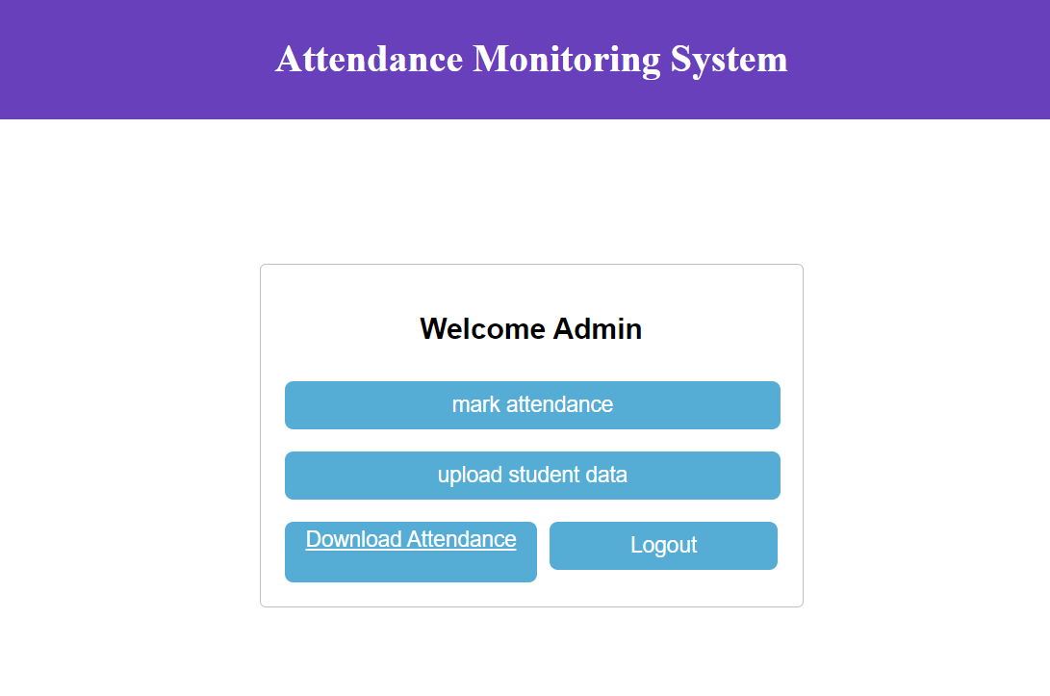
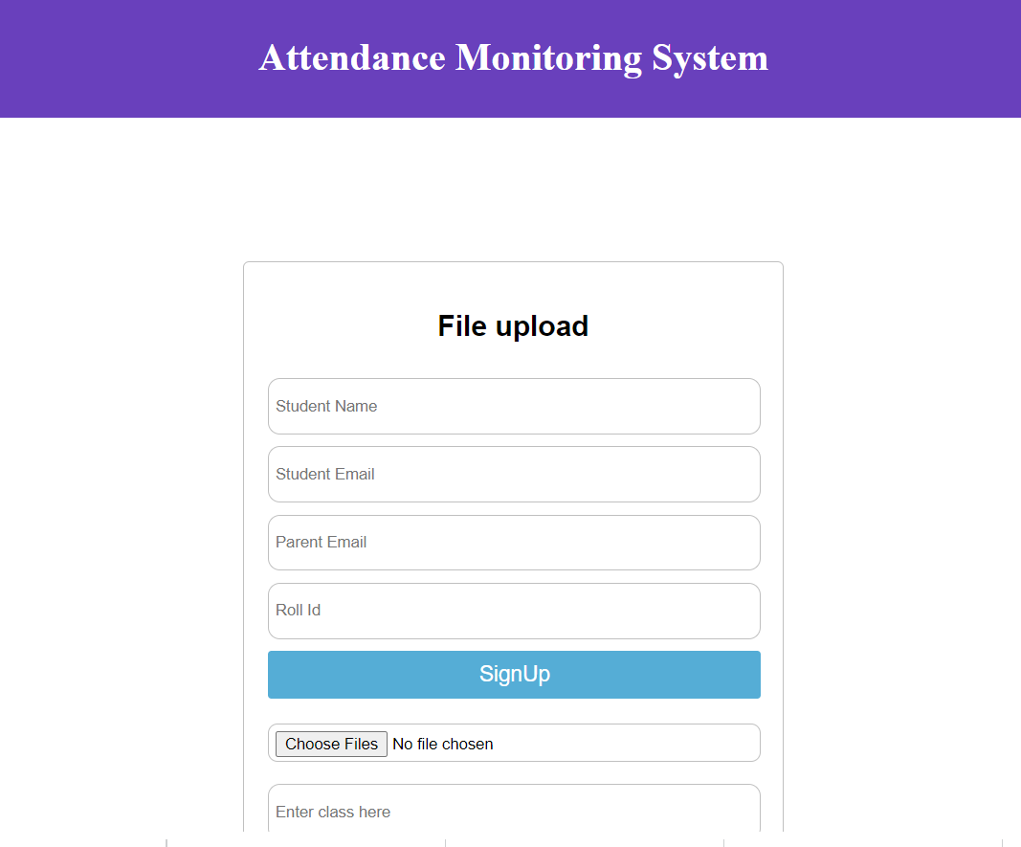
RESULTS
Admin Login
Here, we can Mark Attendance, Upload Student data and Download Attendance
To upload data enter name, other details, upload image and click sign up

Slide 17
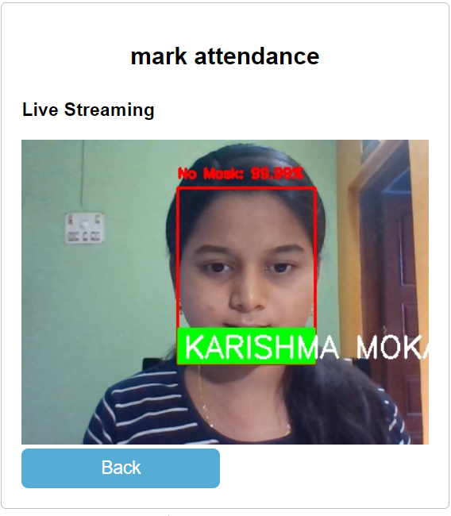
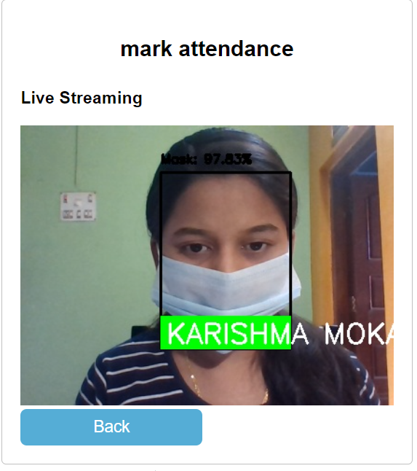
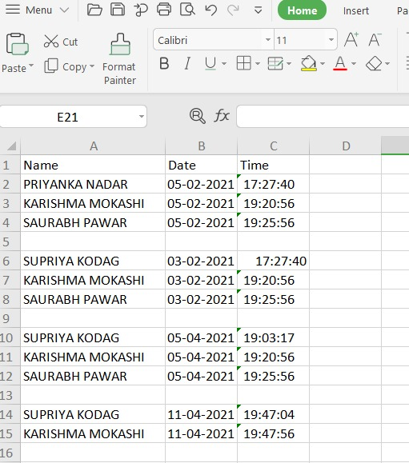
RESULTS
HIGH FEVER
HEADACHE
Fig3.
Sample of downloaded attendance sheet
Fig1.
Real-time image with
no mask
Fig2.
Real-time image with
mask

Slide 18
SOFTWARE DEVELOPMENT TOOLS
The following software tools were used during the development process.
Visual Studio
Python 3.6.8
Flask web framework
XAMPP server
HTML
MS-Excel

Slide 19
CONCLUSION
During this pandemic situation existing face recognition technology will easily fail to make efficient recognition.
The proposed system improves the face recognition attendance process in the presence of masks using deep learning-based methods.
Moreover this is not limited to this pandemic as people wear masks to take care of their health and protect themselves against pollution.
In the proposed system, mask detection technology can be used to identify faces in the crowd wearing masks or not.
In future, notification to the student can be sent once the attendance is marked.

Slide 20
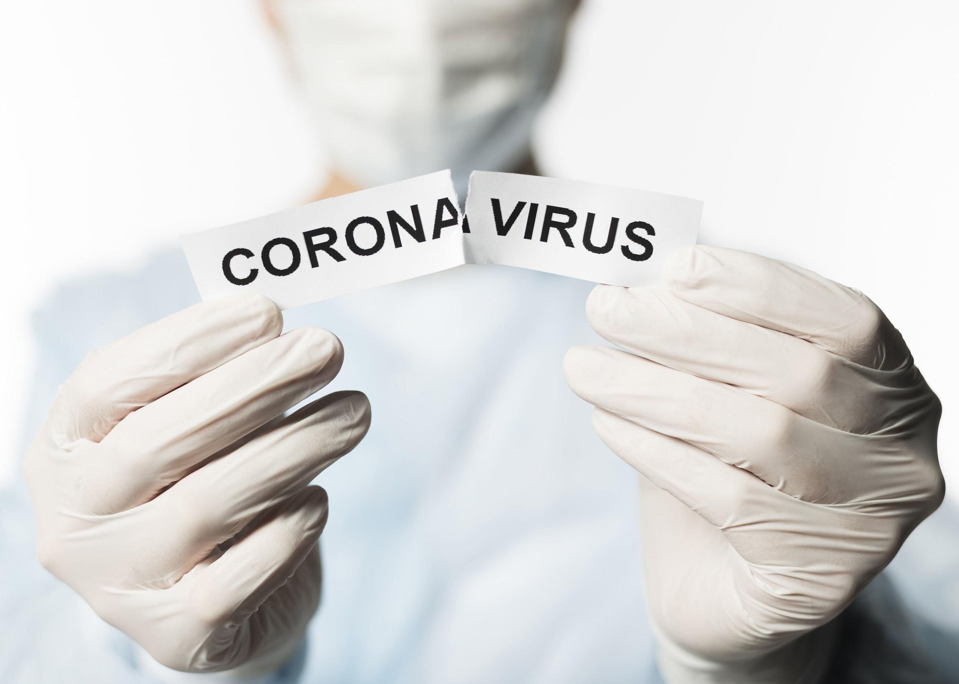
THANKS!

